Slide 1

WORKPLACE POLICY IN PUBLIC HEALTH
Kaye Melnick, MSN, RN

Slide 2


Purpose of Policies and Protocols in Public Health
Alabama Department of Public Health
Bureau of Field Operations – Office of Clinical Management and Practice
ADPH Policies and Protocols
ADPH Standing Orders
Conclusion
TOPICS

Slide 3

Introduction
Policies and protocols are essential tools for public health looking to operate efficiently, comply with regulations, and promote a positive organizational culture (internalized patterns of behaviors). By establishing clear guidelines and protocols, public health agencies can reduce the risk of errors, promote consistency, and create a sense of shared purpose among employees. This holds true for any health department organization regardless of the organizational structure and the number of employees.

Slide 4
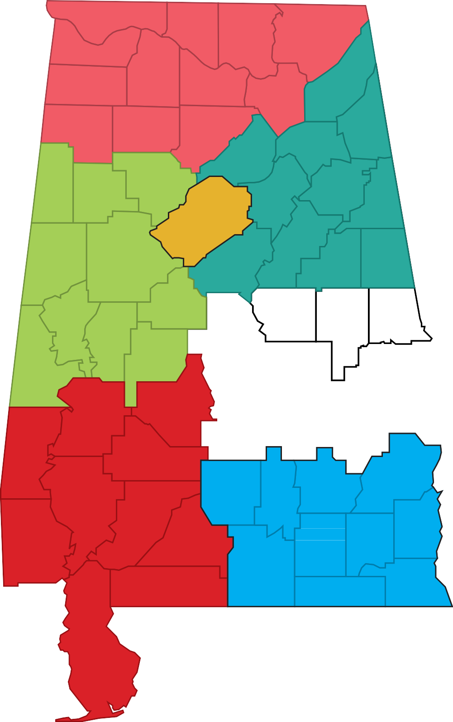









Alabama Department of Public Health
Lauderdale
Limestone
Madison
Jackson
Colbert
Franklin
Marion
Lawrence
Morgan
Northern
Winston
Marshall
DeKalb
Cullman
Cherokee
Blount
Etowah
Northeastern
Calhoun
St. Clair
Cleburne
Lamar
Fayette
Walker
Jefferson
Jefferson
Talladega
Pickens
Tuscaloosa
Shelby
Clay
Randolph
West Central
Greene
Hale
Bibb
Coosa
Chambers
Comprised of 6 public health districts
65 Counties, 71 county health departments
Chilton
Tallapoosa
East Central
Sumter
Perry
Elmore
Lee
Autauga
Dallas
Montgomery
Macon
Choctaw
Marengo
Russell
Lowndes
Bullock
Wilcox
Southwestern
Clarke
Monroe
Washington
Pike
Barbour
Butler
Southeastern
Crenshaw
Henry
Conecuh
Coffee
Dale
Covington
Houston
Escambia
Geneva
Mobile
Mobile
Baldwin

Slide 5
BUREAU OF
FIELD OPERATIONS
The office of clinical management and practice is located at the state level and provides administrative support to the areas of nursing, clerical, social work, and electronic health records at the district and county levels. We utilize both the Alabama Board of Nursing and the Social Work Board rules and regulations for standards of practice.
District and county level staff supporting clinical practice:
460 clerical staff
307 nurses
82 social workers
Policies and protocol are created at the state level to guide the operations and workflow at the district and county level.
Policies are a set of rules designed to achieve certain objectives such as the employee’s behaviors, actions, and processes they take in specific scenarios.
Protocol is the completion of a task to achieve a desired solution.
Policies and protocols help ensure consistency in practice
and help to prevent legal issues and loss of grant funding.

Slide 6
ADPH
Policies & Protocols
POLICIES:
Electronic Health Record Downtime – Nursing Division
Guidance should be provided for expectations of continuing to provide services (documenting on paper forms) and time line to enter them into the EHR when it is functioning.
Medical Record Integrity – Nursing Division
Guidance and processes should be provided for any amendment needed in the EHR. Common errors can be scanning records into the incorrect account, incorrect provider signing a note, correction of a vaccine record, etc,)
Nursing License Verification – Nursing Division
With a large number of clinical staff we have a policy for license verification by bureau directors to ensure no one is practicing without a valid license.
PROTOCOLS:
Clinic Protocol Manual – covers protocol for all clinic programs
Title X regulations
Breast and Cervical Can Early Detection Program
340B Drug Program
Childhood vaccines
Nurse Orientation Manual
Social Work Manual
Clerical Orientation Manual
Electronic Health Records User Manual

Slide 7
TITLE X REGULATIONS
The Bureau of Family Health Services administers the Title X grant and program. Partnership with this program is critical within our department.
Recipients of Title X funds must comply with the legislative mandates set out in the Department of Health and Human Services’ appropriations act, which is updated each year. Title X projects must have written policies and procedures in place that address legislative mandates. Title X projects should include administrative, clinical, counseling, and referral services necessary to ensure adherence to these requirements.
As a Title X recipient, we work closely with our Federal Project Officer and Grant Management Officer to receive any updates, changes, and requirements passed down from the Grantor, Office of Population Affairs (OASH)/OPA). Communication is done on a bi-monthly basis via a virtual meeting known as Office Hours. In the event something is emergent (i.e. the overturn of Roe V Wade in June 2022), additional correspondence via emails, calls, White House calls will transpire to update the Grantees on issues and/or new requirements and trainings. Grantee works very closely with their grant management team.

Slide 8
TITLE X REGULATIONS
2021 Regulations
Went into effect on November 4, 2021
Repealed the 2019 regulations, readopted 2000 regulations with revisions
Reinforce the program’s central tenets of quality, equity, and access for all individuals who seek Title X services and modernizes the more than 50-year old program to better reflect the current healthcare system
Key Provisions
Pregnancy options counseling and referrals
Separation of family planning and abortion services
Method access
Telehealth
Income verification
Information and education (I&E) materials review
Confidentiality

Slide 9
ADPH
TITLE X
PROGRAM
Title X and Family Planning Program:
The Family Planning Program promotes the well-being of families, responsible behavior, and healthy mothers and babies. Our goal is to prevent unintended pregnancies through education and contraceptive services, allowing for the planning and timing of pregnancies.
There are 71 ADPH clinics throughout Alabama offering family planning services. We provide a wide range of confidential and professional family planning services to both females and males of all ages. These services are provided regardless of income. Individuals may be eligible for free or reduced cost services.
Family Planning Services
• Physical Exam (including a medical history, Pap smear, clinical breast exam, and height,
weight, and blood pressure check)
• Family Planning counseling and education on all contraceptive methods
• Testing for pregnancy, HIV, and STD
• Birth control supplies
• Sterilization (including counseling, education, and referral)
• Pre-conception counseling (pregnancy planning)
• Care coordination for clients
• HPV vaccines
All services are confidential.

Slide 10
TITLE X
TRAINING REQUIREMENTS
Reproductive Health National Training Center (RHNTC) required Title X Staff Training Requirements:
RHNTC - Required (Once Per Project Period)
1. Title X Orientation: Program Requirements for Title X Funded Family Planning Projects
2. Cultural Competency in Family Planning Care
RHNTC - Required (Once Annually)
1. Trauma-Informed Mandatory Child Abuse Reporting in a Family
Planning Setting
2. Mandatory Child Abuse Reporting in Title X Funded Family Planning
Settings
3. Identifying and Responding to Human Trafficking in Title X Settings
4. Counseling Adolescent Clients to Resist Sexual Coercion
5. Counseling Adolescent Clients to Encourage Family Participation
6. SOAR to Health and Wellness Human Trafficking

Slide 11
TITLE X TRAINING REQUIREMENTS
Trainings (con’t)
RHNTC - Required (Once During Employment)
1. Determining Your Client’s Need for Services and Discussing Reproductive Goals
2. Support for Achieving a Health Pregnancy
3. Sexually Transmitted Infections Services
4. Contraceptive Counseling and Education
5. Pregnancy Testing and Counseling
6. The Family Planning Patient Experience: Skills to Improve Every Visit
LCMS (Learning Content Management System) a web – based ADPH system
(Required once annually) 1. Mandated Reporter of Child Abuse and/or Neglect Training
2. 340B Program: The Essentials of Compliance
3. HIPAA Basics
4. Violence in the Workplace

Slide 12
TITLE X
FPAR 2.0
DATA ELEMENTS
The Family Planning Annual Report (FPAR) 2.0 is the next iteration of FPAR data reporting that will collect encounter- level data for Title X family planning agencies. FPAR 2.0 will allow for improved data collection, reporting, and analysis that will ultimately allow for more opportunities to improve service delivery. The current method of aggregate level FPAR 1.0 data reporting ended December 31, 2022. Local agencies started collecting encounter-level data January 1, 2023, and it will be reported to the Office of Population Affairs (OPA) for the first time in February 2024.
For FPAR 2.0, only the Local Health Department-Health Service Analysis (LHD-HAS) system data will be used for reporting. Once in place, this process will streamline local agency reporting processes and eliminate extra steps. CureMD has the interoperability to capture the data for reporting.
Below is a list with all the required data elements for FPAR 2.0, as well as a diagram showing the flow of data. Most of these elements are already part of clinic visits, captured in the Electronic Health Records (EHRs) and being reported to LHD-HSA. The items highlighted are either new questions or have been slightly revised.

Slide 13
TITLE X
FPAR 2.0
DATA ELEMENTS
FAMILY PLANNING ANNUAL REPORT (FPAR) 2.0 DATA ELEMENTS
Facility Identifier *Counseling to achieve pregnancy was provided
Attending physician NPI Provider Systolic blood pressure
Provider Role Diastolic blood pressure
Patient Identifier Body Height
Visit Date Body weight
Birth Date Tobacco smoking status
Sex Pap test formed at this visit
Limited English Proficiency Pap smear test result
Ethnicity *HPV test performed at this visit
Race *HPV test result
Annual Household Income Chlamydia test performed at this visit
Household size [#] *Chlamydia test result
Payer for visit Gonorrhea test performed at this visit
Gender Identity *Gonorrhea test result
Pregnancy Status HIV test performed at this visit
Pregnancy Intention *HIV test result
*Contraceptive method at intake reported – at intake Syphilis test permed at this visit
*Reason for no contraceptive method use Reported – at intake *Syphilis test result
*Contraceptive method at exit reported – at exit *Do you want to talk about contraception or pregnancy prevention during your visit today
*Reason for no contraceptive method use reported – at exit *Sexual Orientation
*How contraceptive method was provided
*Contraceptive counseling was provided

Slide 14
TITLE X
FPAR 2.0
DATA ELEMENTS

Slide 15
ALABAMA BREAST & CERVICAL CANCER EARLY DETECTION PROGRAM
(ABCCEDP)
PURPOSE OF THE BREAST AND CERVICAL PROGRAM:
To improve access to breast and cervical cancer screening, Congress passed the Breast and Cervical Cancer Mortality Prevention Act of 1990, which directed CDC to create the National Breast and Cervical Cancer Early Detection Program (NBCCEDP). The NBCCEDP funds award recipients in all 50 states, the District of Columbia, 2 U.S. territories, 5 U.S.-Affiliated Pacific Islands, and 13 American Indian and Alaska Native tribes or tribal organizations.
The Alabama Breast and Cervical Cancer Early Detection Program (ABCCEDP) provides free breast and cervical cancer screenings for women who meet the following criteria:
Women who live in Alabama with a household income at
or below 250% of the Federal Poverty Level.
Women who have no insurance or are underinsured.
Women who meet the age and other eligibility requirements.
FREE CERVICAL CANCER SCREENING

Slide 16
ALABAMA BREAST & CERVICAL CANCER EARLY DETECTION PROGRAM
(ABCCEDP)
ABCCEDP (CON’T)
Screening Requirements:
Determine eligibility based on income, age, and insurance status
Complete the screening form (found on the ABCCEDP website) for each participant and submit to the appropriate Regional Coordinator along with billing or appropriate HCFA form
Provide required screening and educational services
Patient Education:
Providers are required to provide women with information and educational serviceson the early detection of breast and cervical cancer. The purpose of the education component is to provide women with the information necessary to:
Understand the screening procedures used in the detection of breast and cervical cancer
Motivate the participant to comply with recommended guidelines for screening as it relates to present appointment and future screening practices
Provide education and information appropriate for the participant’s age, lifestyle, educational level, and ability to understand. This instruction should be documented in the participant’s record and she should be allowed an opportunity to ask questions and verbalize her understanding of the educational information presented

Slide 17
ALABAMA BREAST & CERVICAL CANCER EARLY DETECTION PROGRAM
(ABCCEDP)
ABCCEDP (CON’T)
ADPH Senior NP’s are trained under one of our OB/GYN physician’s and have passed certification to perform colposcopies, can provide this service to patient’s meeting the criteria based on cervical screening results. Many of patients consider the health department their medical home. Transportation is also a barrier to healthcare for some of our patients.
The ABCCEDP grant funds cover the cost for diagnosis and screening for individual's who meet the eligibility criteria.
The ABCCEDP program has contract providers funded by the grant to provide diagnostic services (mammography, breast ultrasound, colposcopy, surgical or GYN consult, fine needle aspiration, breast biopsy)
For individuals at or under the 250% of the FPL, they are referred to the ABCCEDP Nurse Coordinator to enroll for Full Alabama Medicaid for additional needed services such as surgical and oncology treatment.

Slide 18
ALABAMA BREAST & CERVICAL CANCER EARLY DETECTION PROGRAM
(ABCCEDP)
ABCCEDP (CON’T)
Tracking and Follow-Up:
Each health care provider and facility must:
Utilize a tracking protocol that assures effective communications with the participant, health care providers, and laboratory personnel
Maintain a record of Pap tests, HPV testing, and mammograms done to ensure results are received in a timely manner
Address barriers that cause difficulty with recommended follow-up
Facilitate proper follow-up for women with abnormal screening results, as well as annual re-screen
Maintain a screening system to notify women as screenings are due

Slide 19
ALABAMA BREAST & CERVICAL CANCER EARLY DETECTION PROGRAM
(ABCCEDP)
ABCCEDP (CON’T)
Missed Abnormal Follow-up Appointments:
Providers must contact the participant for missed appointments for diagnostic or treatment procedures. These should begin with a phone call, then a letter or post card, and finally a certified letter. This would usually occur over a 30-60 day time period
If after two months from the abnormal screening results, the participant does not respond to documented repeated phone contacts and/or a certified letter to schedule additional diagnostic procedures, the work-up disposition will be entered in the ABCCEDP data system as one of the following:
Lost to follow-up - if the participant cannot be contacted via phone, post card,
or certified letter
Work-up refused - if the participant refuses additional diagnostic tests or does
not show twice for scheduled follow-up appointments
The screening cycle will be closed at that time. A participant lost to previous
follow- up attempts shall not be denied future screening services

Slide 20
340B DRUG DISCOUNT PROGRAM
The Pharmacy Division oversees the 340B Drug Program for ADPH.
The partnership we have with the ADPH State Pharmacist is critical in maintaining compliance and being prepared for audits.
Within the last year a Pharmacy Technician has been hired to oversee the 340B audit process. They function as the 340B liaison between the program managers, nursing, and pharmacy. They also they perform random audits and feedback to the clinic staff

Slide 21
340B Drug Discount Program
The 340B Drug Discount Program is a federal government program that requires drug manufacturers to provide outpatient drugs to eligible covered entities at significantly reduced pricing.
The intent is to allow covered entities to stretch scarce federal resources.
The savings are used to provide healthcare services to more patients and/or provide more comprehensive services.

Slide 22
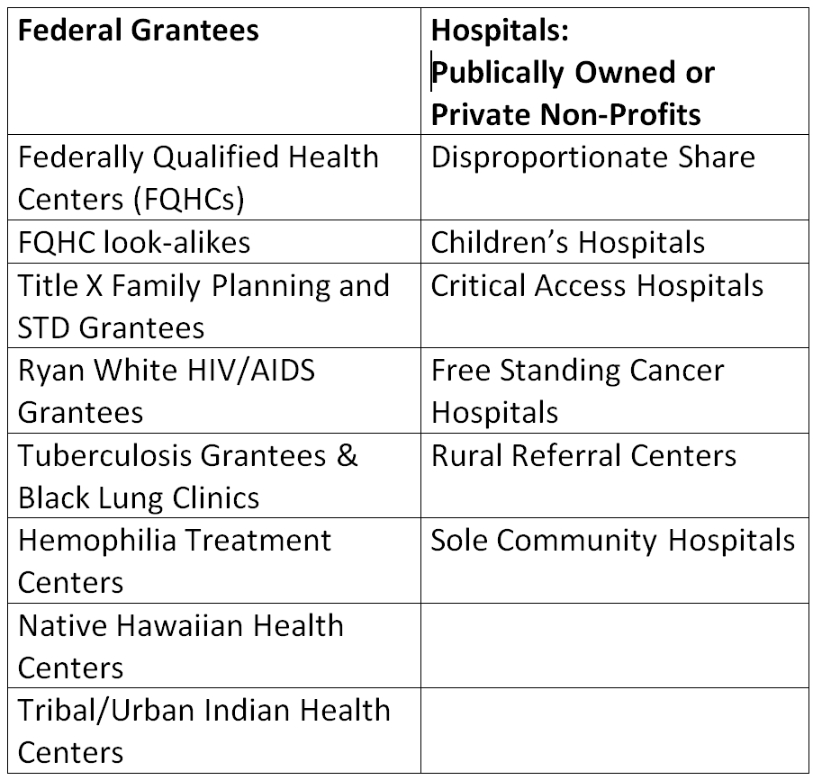
340B DRUG
DISCOUNT PROGRAM
Covered Entities
Safety net providers including, but not limited to, non hospitals, such as county health departments, are eligible to participate in the 340B Program.
Entities are considered eligible on the basis of their federal designations or receipt of funding from specific federal sources and are statutorily described as “covered entities”.

Slide 23
340B DRUG
DISCOUNT PROGRAM
Management
The Office of Pharmacy Affairs (OPA) is the division within the Health Services Resources and Administration (HRSA) that manages the 340B Program.
As a condition of participation in the 340B Program, covered entities must register with OPA and are required to recertify annually.
OPA requires that covered entities list every covered entity site, or location, on the OPA online database.
OPA has taken the position that failure to register or list a site on the agency’s website disqualifies the site.
HRSA Office of Pharmacy Affairs 340B OPAIS can be found at https://340bopais.hrsa.gov/ .
  It is the official listing of 340B eligible entities.
  The covered entity must maintain information in the database to ensure that it is accurate, up-to-date, and reflects what the organization is doing in practice.
  It is used by wholesalers and pharmaceutical manufacturers to ensure the entity is 340B certified while buying medications with 340B pricing.
  It does not require a log in.
  340B OPAIS User Guide can be found at https://www.hrsa.gov/sites/default/files/opa/files/publicuserguide.pdf

Slide 24
340B DRUG
DISCOUNT PROGRAM
Recertification
340B Recertification:
The covered entity must apply for recertification once a year.
The covered entity must verify that
  The information in the OPA 340B OPAIS (information system) is accurate and up-to-date.
  It is still eligible.
Recertification does not occur the same time each year so the Authorizing Official (AO) must watch for communication from HRSA.
The Family Planning, STD and TB designated central office staff serve as AOs.
HRSA will send an email to the AO and the alternate announcing the recertification period.
Only the AO can complete the recertification process.
The day recertification begins, HSRA will send the AO an email with specific instructions including the link and log in information.
The AO must log in via the link and change the temporary password provided in the email.
The AO edits or confirms the information and submits it for recertification.
HSRA accepts or denies recertification.

Slide 25
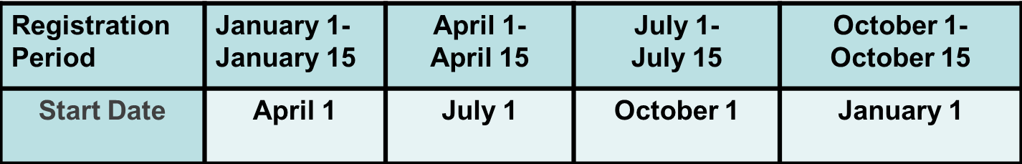
340B DRUG
DISCOUNT PROGRAM
Change of Scope
Registration and any change in scope of services is conducted online during the first 15 days of the quarter and is effective on the first day of the next quarter.
  Example: A county health department opens a satellite facility to provide family planning services. The registration of this location can occur only during the first 15 days of the quarter (such as April 1-15) and will become effective July 1.
A change in scope can be an addition or deletion of services.
No 340B medications can be dispensed from a location until it is certified.

Slide 26
340B DRUG
DISCOUNT PROGRAM
Compliance
340B Compliance:
Each covered entity must maintain auditable records showing that:
  The patient is eligible.
  Medicaid does not reimburse for a medication that qualifies for a rebate.
  All criteria for eligibility are met.
Covered entities may be audited by HRSA and pharmaceutical manufacturers to assure compliance of its 340B operations.
Entities must self-disclose programmatic violations, also called material breaches.

Slide 27
340B DRUG
DISCOUNT PROGRAM
Definition of a Patient
Definition of a 340B patient:
Covered entity must have an established relationship with the patient and maintain a record of the patient’s health care.
A patient will not be considered a patient of the covered entity if the only health care service received by the individual from the covered entity is the dispensing of a drug or drugs for subsequent self-administration or administration in the home setting.
The covered entity is responsible for health care of patient, including when the patient is referred for services outside the covered entity.
The patient receives services or a range of services consistent with services for which grant funding has been provided to the entity.
The covered entity must provide the patient health care services in addition to medications.

Slide 28
340B DRUG
DISCOUNT PROGRAM
Types of Material Breaches and Reporting
Diversion occurs when
  340B purchased medication is dispensed to a patient who is not eligible,
  the entity dispensing 340B medications is not certified by HRSA.
  Duplicate discount occurs when Medicaid receives a rebate from the drug manufacturer for discounted 340B purchased medications.
  DIVERSION AND DUPLICATE DISCOUNT:
  To avoid diversion, it is crucial to understand how “patient” is defined in the 340B Program.
  Family Health Services at ADPH has established a billing procedure with Medicaid that ensures duplicate discounts will not occur.
  At this time, TB and STD do not bill Medicaid for medications dispensed in the county health departments.
  REPORTING A MATERIAL BREACH:
Any staff member who identifies a potential material breach should immediately notify his/her supervisor.
The supervisor will inform district administrative staff who will investigate the event and report it to the program manager within 3 business days.
No retaliation toward an employee will be taken for reporting a potential material breach.
Any and all material breach events that are non-correctable within a reasonable time frame will be reported to OPA by the program manager.

Slide 29
340B DRUG
DISCOUNT PROGRAM
Inventory
340B Inventory:
340B purchased medications must be stored separately from medications purchased from other funding sources and dispensed only to 340B eligible patients.
Each program (Family Planning, TB, and STD) must keep separate physical inventories.
HRSA regulations do not allow transferring of 340B purchased medications to other 340B certified entities.
ADPH has requested a HRSA waiver to allow medications to be transferred to another ADPH 340B certified entity if the scope of service is the same and there is a justifiable reason for the transfer.
Approval from the Program Manager must be received before medications are transferred.

Slide 30
340B DRUG
DISCOUNT PROGRAM
HRSA
Audit Process
HRSA Audits:
HRSA audits can be random or targeted and looks for:
  Eligibility
  Diversion
  Duplicate discounts
The HRSA auditor will review:
  Policies and Procedures
  Patient health records
  Other auditable records
    Procurement
    Inventory
    Drug distribution
    Other auditable records
Tools to promote 340B compliance https://www.340bpvp.com/education/340b-tools/ .

Slide 31
340B DRUG
DISCOUNT PROGRAM
Self Audit
PROCESS
Self Audits:
Ensures procuring, maintaining, and dispensing medications and maintaining records accurately reflects the entity’s Policies and Procedures.
Review of patient records and inventory transfer documentation to identify any diversion or duplicate discounting.
Must be consistent, thorough and scheduled regularly.

Slide 32
340B DRUG
DISCOUNT PROGRAM
ADPH Self Audit
Self Audits (Con’t)
The 340B audit schedule ensures that all county health department FP, STD, and TB programs are audited at least once every two years.
The first week of the month after each calendar quarter (January, April, July, and October), the Audit Coordinator will randomly select four FP, four STD, and two TB records to be audited and will send the list to the Program Managers. The Program Manager will audit pre-selected patient records and the 340B inventory using CureMD.
Audit results must be sent to the District Clinic Director by the end of the month.
The Program Managers communicates audit results to the Department of Nursing, District Clinic Director(s), and others as appropriate.
If needed, the District Clinic Director will assist the clinic supervisor in developing a corrective action plan (CAP). If a CAP is needed, the clinic site will be reaudited in 6 months to ensure corrective action has been made.
The plan must be approved by the 340B Coordinator who monitors progress, ensuring that the plan is followed.
Any material breach or diversion violation identified must be reported as stated above.

Slide 33
340B DRUG
DISCOUNT PROGRAM
“Pearls” of Wisdom
“Pearls” of Wisdom:
Make an offensive plan to establish and maintain the integrity of the 340B program within your facility.
Empower a staff member from your facility to become an expert and utilize them as an internal audit administrator.
Auditing yourself now may allow for an easier audit in the future.
Identify your deficiencies and correct before the auditor arrives.
Educate, educate, educate.

Slide 34
340B DRUG
DISCOUNT PROGRAM
Inventory Audit Process
Inventory Audit Process:
Are there any discrepancies that may indicate non 340B eligible patients receiving 340B drugs?
Are there clear and auditable ways to identify eligible patients?
Is there a sound way to manage referrals for care provided outside your facility?
Assess your inventory management for eligible and non-eligible patients.
Examine the process for identifying patients that qualify for the 340B program.
Review accuracy of the quantity units that are dispensed for match with ordering quantities.
Track drug specifically purchased for TB, STD, or FHS from purchase to exiting the county health department.
Ensure that it remains in supply only for specific grant.
Randomly select a product.
Reconcile.
  Total quantity dispensed to all patients
  With total quantity purchased by clinic

Slide 35
340B DRUG
DISCOUNT PROGRAM
APEXUS
Apexus is the 340B Prime Vendor and contracts with wholesalers for distribution, negotiates with manufacturers for sub-340B pricing, and is a resource for covered entities with questions regarding the 340B rules.
https://www.Apexus.com
Offers online 340B education, 340B University OnDemand.
340B University on Demand is required for district and central office staff who are responsible for programs that purchase 340B medications.
Modules that are 10-30 minutes in length.
Go to https://www.340bpvp.com/education/340b-u-ondemand/ .
Click on 340B Education Portal.
Click on Covered-Entities.
Sign up as a new user.

Slide 36
ADPH STANIDNG ORDERS
Overview:
Empowers both clinical and non – clinical staff at the county level to deliver high – quality evidenced – based care that can be integrated into the county health department workflow.
Standing orders are written as guidelines to county health department staff providing a service outside of the electronic health record and outside of protocol.
Examples:
Covid – 19 Vaccines
Emancipated Minors Receiving a Covid – 19 Vaccine
Flu Vaccines
Medical Needs Shelter
Nurse Practitioner Collaborative Disclaimer
Family and Women’s Health Clinic and Off – Site Standing Orders

Slide 37





Conclusion
Clear organization policies and protocols are a must for every organization, including the Department of Public Health, regardless of its size. If you have employees, you need policies and protocols.
Tie Policy Goals to Organizational Needs:
Consider your health department circumstances (mission, categorical services provided, size, objectives, and values), so that your policies align with them.
Promote your policies and protocols
Make sure they are easy to understand
Prepare employees prior to implementation
Evaluate and revise periodically

Slide 38


Thank you
QUESTIONS ?
Kaye Melnick
Chief Nursing Officer
Alabama Department of Public Health
kaye.melnick@adph.state.al.us
It’s important to have a sound idea, but the really important thing is the implementation. Wilbur Ross

